Slide 1
Cellular Transport
By: Alexandra

Slide 2
Definition Of Diffusion
Diffusion is the movement of particles from a higher concentration to a lower concentration. The process of diffusion continues until the particles are evenly distributed.

Slide 3
Examples Of Diffusion
Some examples of objects that use diffusion is the smell of perfume when it spreads through a room, the smell of fresh baked cookies throughout the house and when a helium balloon slowly deflates to distribute the helium.

Slide 4
Definition Of Osmosis
Osmosis is a kind of diffusion that involves only the movement of water through a selectively permeable membrane. Osmosis helps the cell because it allows substances the cell needs to go in and keeps the bad substances out.

Slide 5
Examples Of Osmosis
Some examples of osmosis are strainers, water purifiers, tea bags, coffee filters and food.

Slide 6
Other Definitions
Cellular Transport- movement of substances in
and out of the cell.
Permeable- particles can pass through easily.
Impermeable- particles can not pass through.
Selectively Permeable- only allows some substances through.

Slide 7
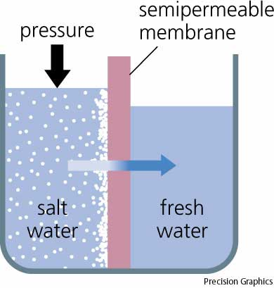
OSMOSIS

Slide 8
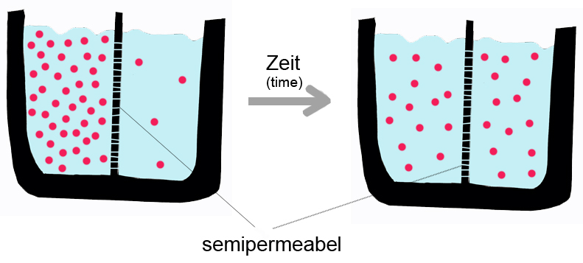
DIFFUSION

Slide 9
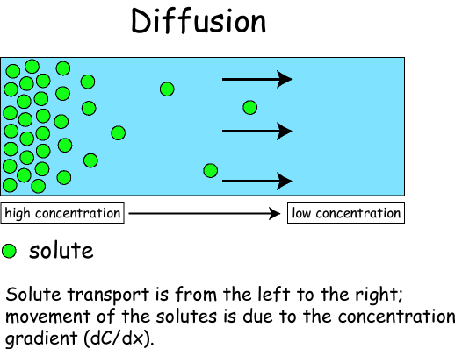

Slide 10
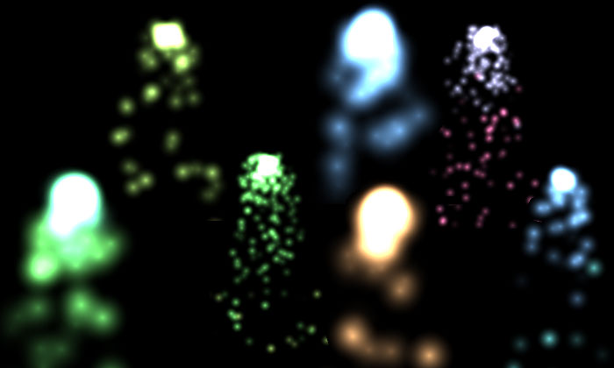
A Poem About Diffusion by:Alexandra

Slide 11

From a high concentration to a low concentration,
The particles give their demonstration.

Slide 12
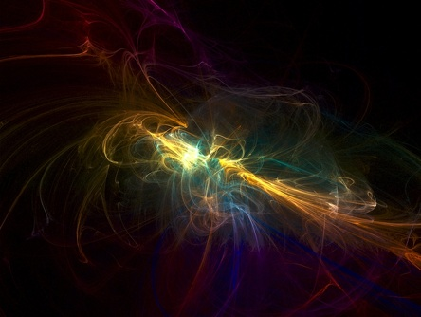
First there’s a smell over here,

Slide 13
Suddenly it’s over here.

Slide 14
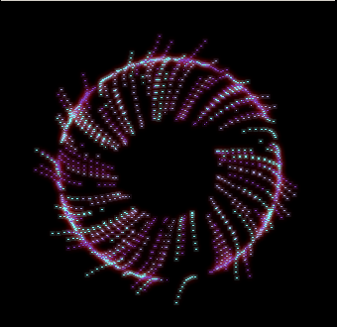
Even amounts everywhere. Even amounts every where. Even amounts everywhere. Even amounts everywhere. Even amounts everywhere even amounts everywhere. Even amounts everywhere. Even amounts everywhere. Even amounts everywhere. Even amounts everywhere. Even amounts everywhere. Even amounts every where. Even amounts everywhere. Even amounts everywhere. Even amounts everywhere.

Slide 15
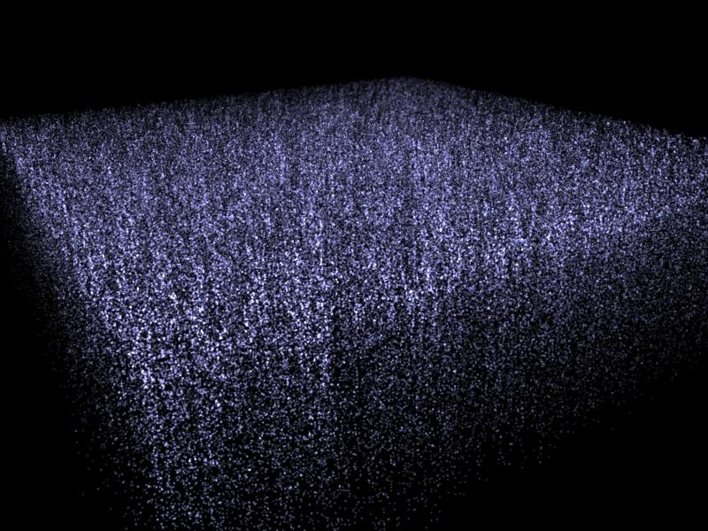
It mixes... Here and there there
and
here there here
here and there
and there here
here and
there and

Slide 16
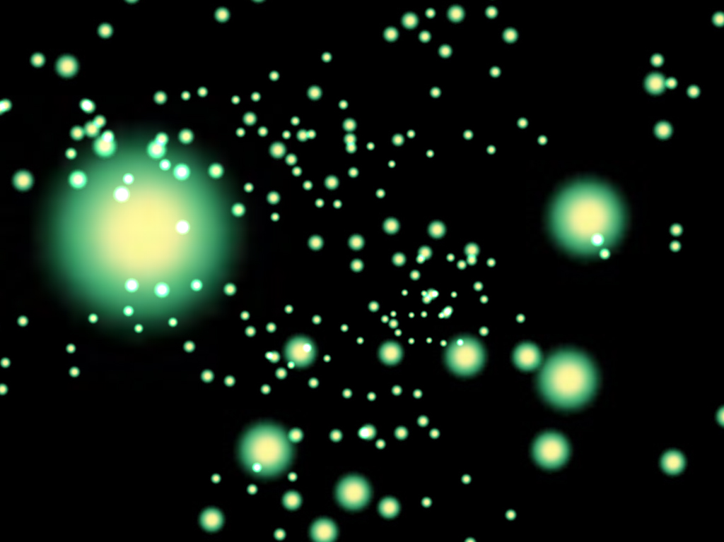
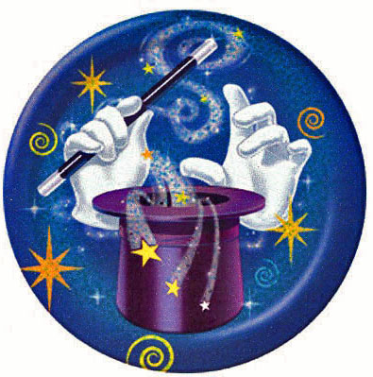
Magically it moves
From here across the
room

Slide 17
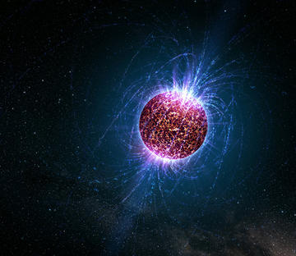
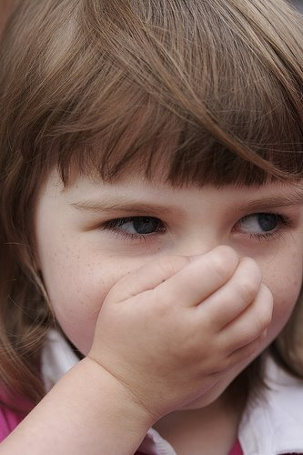
Now everyone can smell

Slide 18
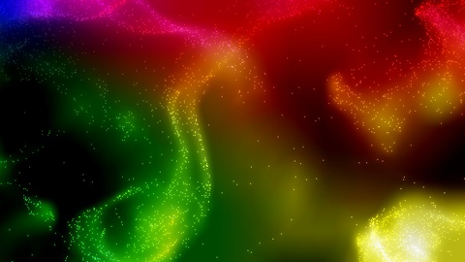

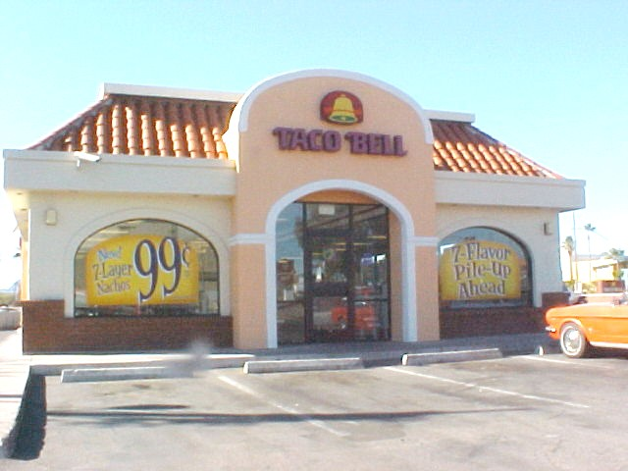
Diffusion from Taco Bell.

Slide 19

THE END

